Slide 1

Acropolis Institute of Technology & Research
Personality prediction system for technical Institute Faculty Using Data Mining
Guided By : Submitted By :
Prof. Ronak Jain Abhinav Dongre (0827IT151003)
Abhishek Dubey (0827IT151004)
Ankit Sakargayen (0827IT151017)
Ayush Kumar Bokade (0827IT151024)

Slide 2
Introduction
This will enable a more effective way to short list submitted candidate form from a large number of applicants .
Providing a consistent and fair ranking policy. System will rank the experience and key skills required for particular job position then system will rank the based on the experience and other key skills which are required for particular job profile. This system will help the HR department to easily shortlist the candidate based on the ranking policy.The decision will be taken by applying the data input and classification algorithm with decision tree of Data mining.

Slide 3
Problem Definition
In the existing system, which candidate is suitable for required job we can take decision by using candidate Data which can be in the form of Hard copy or Software generated CVs.
In the existing system large number of CVs are unable to figure out which candidates are deserving or not.

Slide 4
Advantages
This system will reduce workload of the human resource department.
This system will help the human resource department to select right candidate for particular job profile which in turn provide expert workforce for the organization.
Admin or the concern person can easily shortlist a candidate based on their personality test and the academic details.
The system will retrieve data fastly on Integrating with Hadoop.

Slide 5
LIMITATIONS
May provide inaccurate results if data entered is wrong.
It initially confined to technical institute Faculties

Slide 6
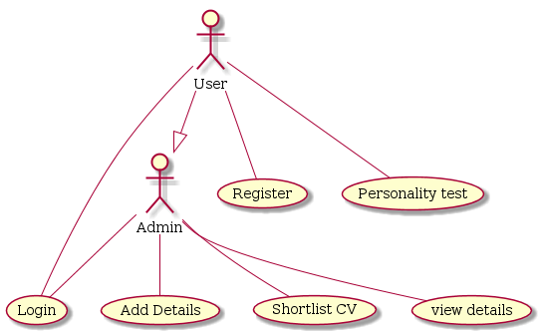
Use Case Diagram

Slide 7
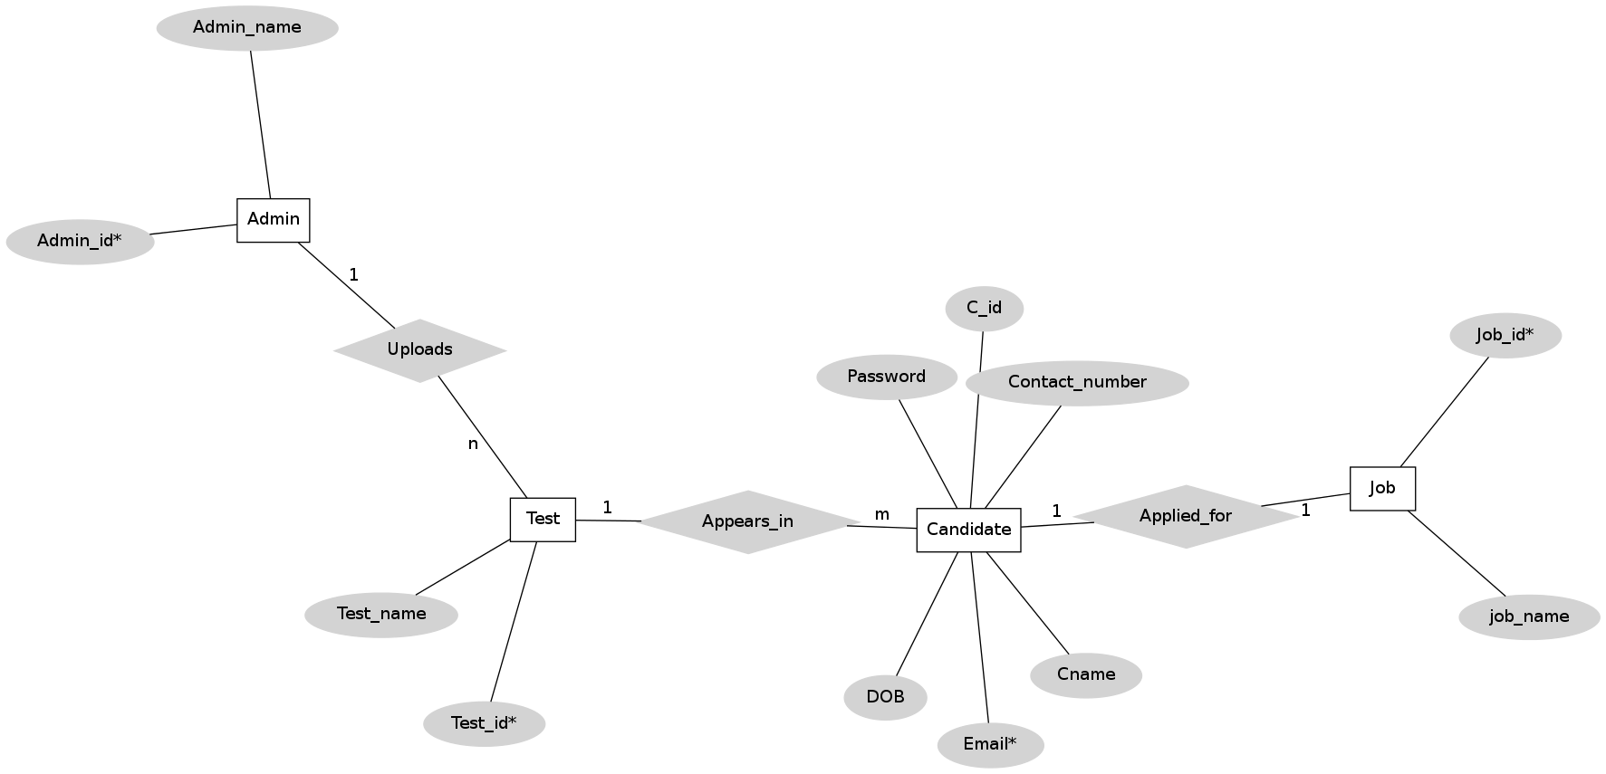
ER - DIAGRAM

Slide 8
Classification Algorithm With Decision Tree
An excel file will be prepared when all the Candidates have filled the form.The data from excel file will be fetched and will be given as input to Classification algorithm.
The Decision Tree will be generated .

Slide 9
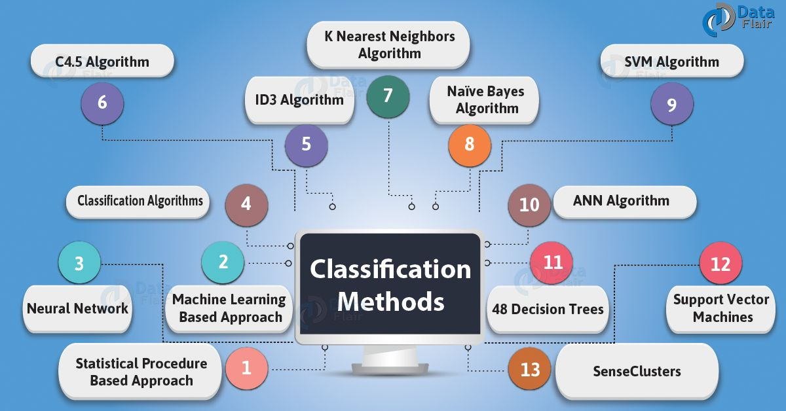
CLASSIFICATION ALGORITHM

Slide 10
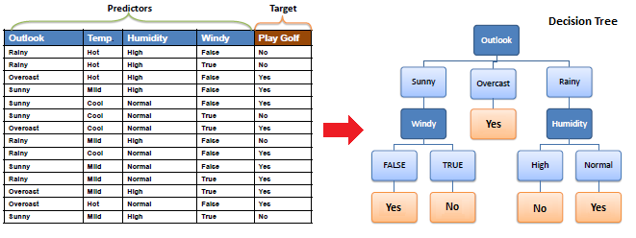
DECISION TREE

Slide 11
Solution Proposed
There will be two which will named as personality
Personality details form
Academic details form
Candidates will fill the application form who are interested in applying for that vacancy.
Shortlisting of candidates for that role in a company by applying suitable constraints.
After shortlisting,the selection procedure for the selected candidates will be followed as per the company guidelines.

Slide 12
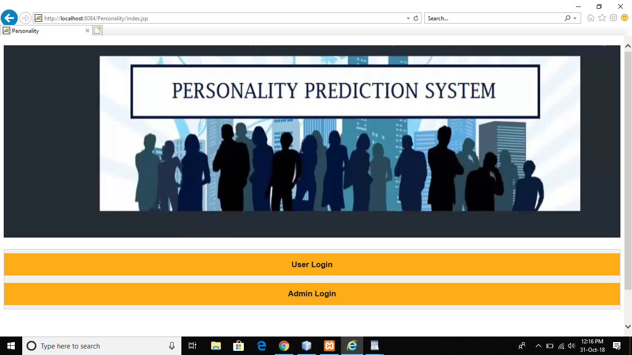

Slide 13
THANKYOU

